Slide 1
A Dog’s Life
Proposal

Slide 2
Site Map
HOME PAGE
Grooming Services
Map to Shop
Contacts
How select a good pet

Slide 3





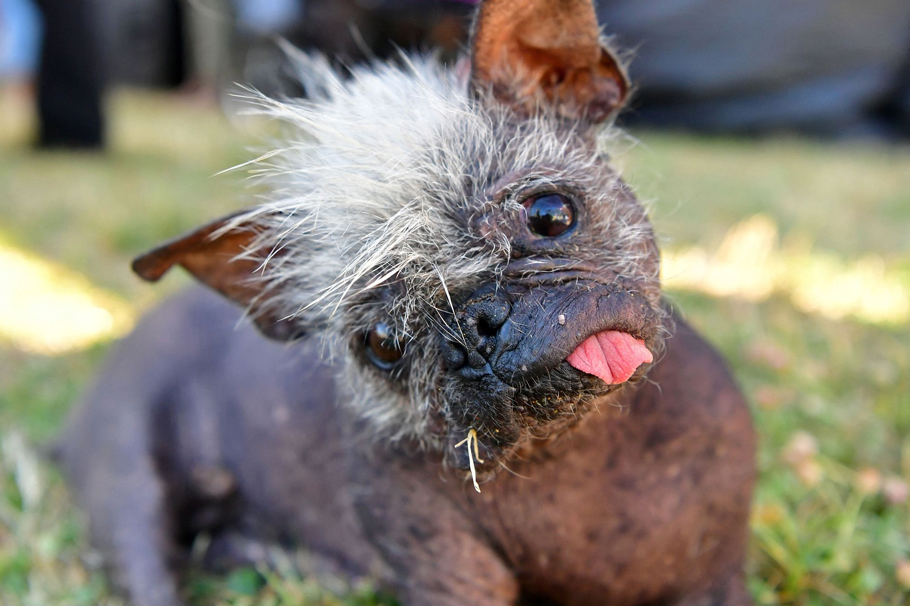
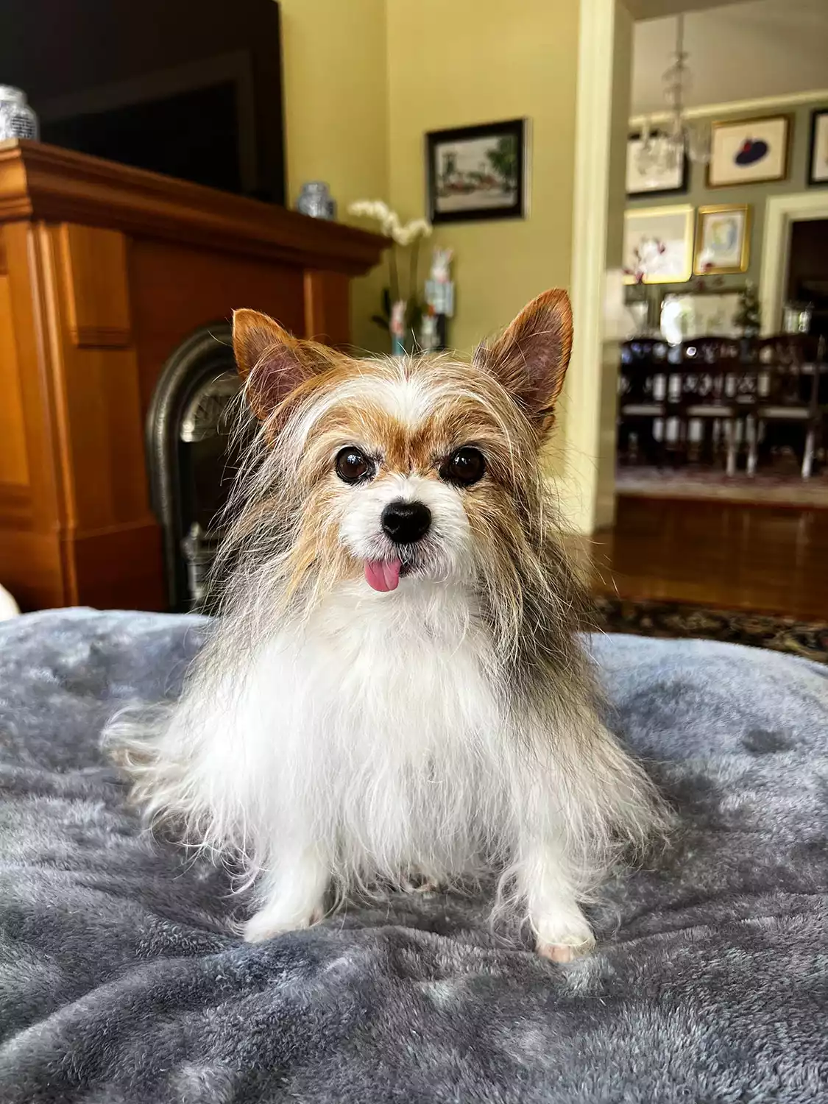
Home Page
Map to
Shop
Contacts
Grooming
Services
Before After
Monday Closed
Tuesday 7:00 am - 3:00 pm
Wednesday 7:00 am - 3:00 pm
Thursday 7:00 am - 3:00 pm
Friday 7:00 am - 3:00 pm
Saturday 7:00 am - 3:00 pm
Sunday Closed
Where we can make even the ugliest do look pretty!

Slide 4


Grooming Services
Map to
Shop
Contacts
How select a good pet
Services
Nail Trimming
Teeth Brushing
Flea and Tick Treatments
Oatmeal Shampoos
Hot Oil Treatments
Anal Gland Checks
Ear Cleaning

Slide 5
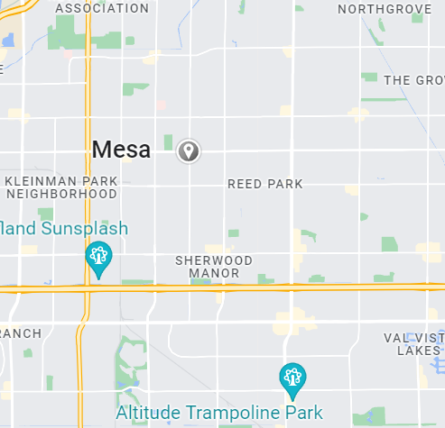
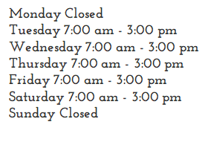
Map to Shop
Contacts
Grooming
Services
Map to
Shop
We are Here
1234 Main St.
Mesa,Az 12345
(480)555-1234

Slide 6
Contacts
Map to
Shop
Contacts
Grooming
Services
Countact Us
1234 Main St.
Mesa,Az 12345
(480)555-1234
Name: Email: Phone:
Comments:

Slide 7
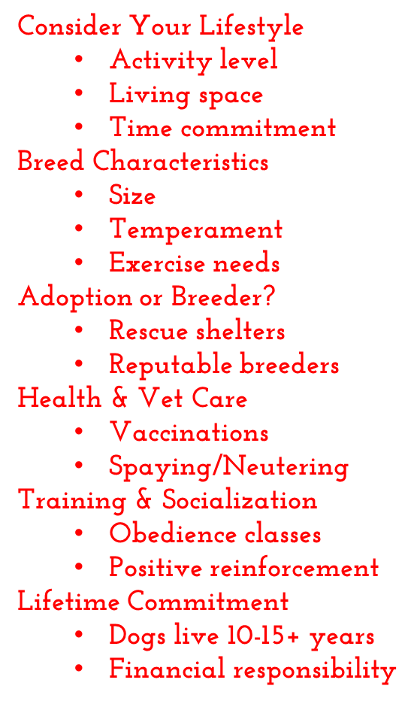




How select a good pet
Grooming
Services
How Select A Good Dog

